Slide 1

Analysis and Prediction Of Boat's Views
Prepared By : Sami SHOKER
Presented to : The Product Manager

Slide 2
1. Work Motivation
2. Exploratory Data Analysis Findings
3. Predictive Model’s Findings
4. Results Summary and Next Steps Suggestions.

Slide 3
Motivation
Business Problem :
Boost Traffic to Website
Work Plan
Analyze the relationship between the number of views with respect to all the other characteristics.
Study the possibility of trimming the current survey to increase the number of people who sign up.
Build a predictive model in order to prevent listing boats that won’t get high number of views.
Assess the predictive power of the boat’s characteristics.

Slide 4
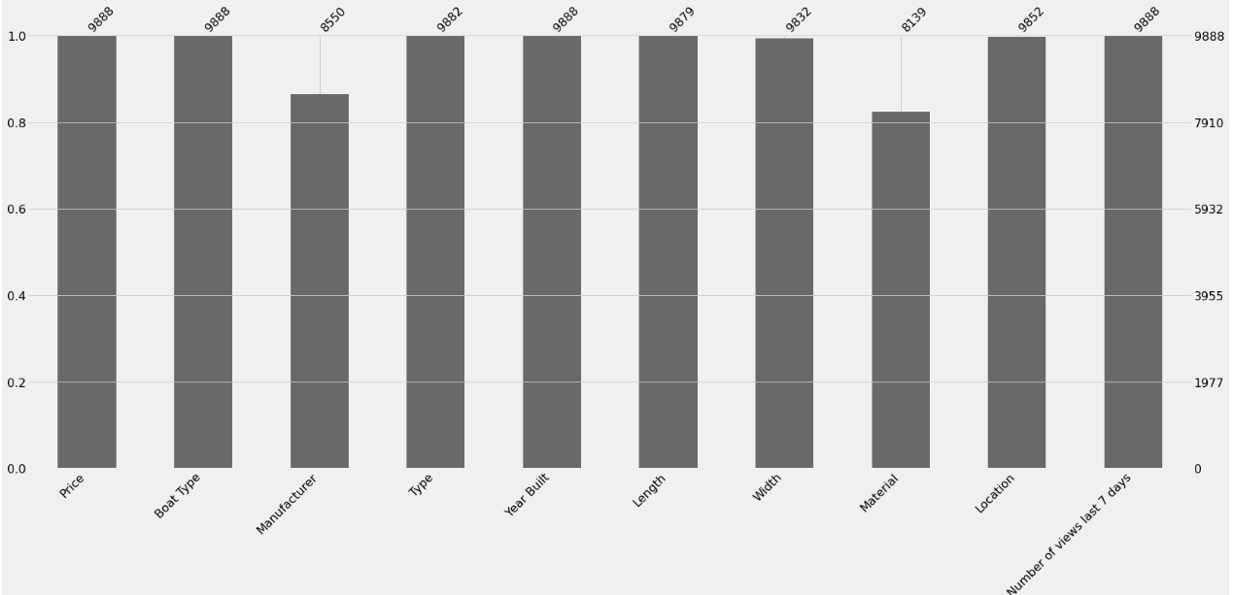
Missing Values

Slide 5
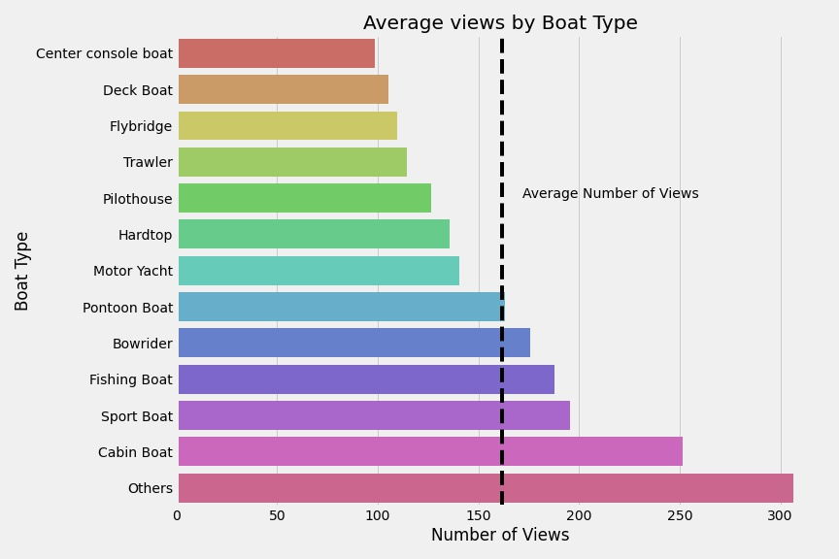
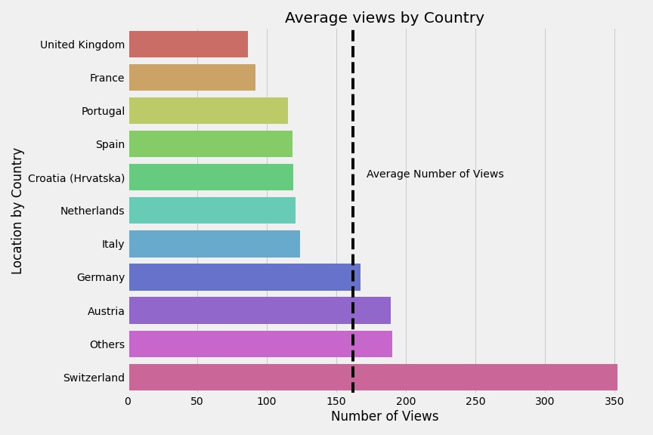
Exploratory Data Analysis Findings:

Slide 6
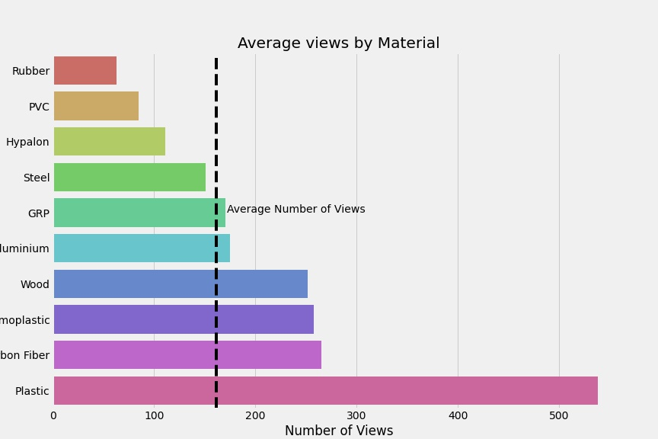
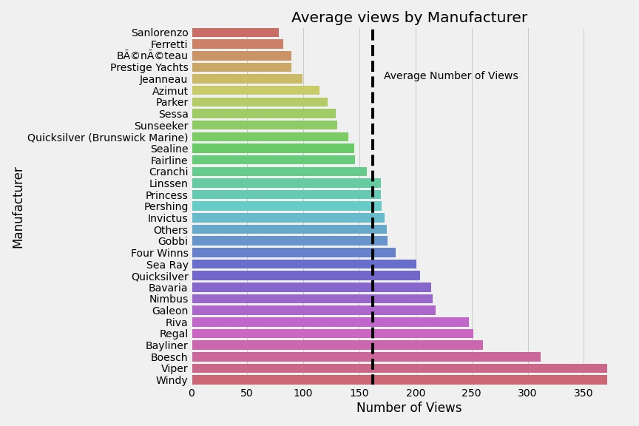
Exploratory Data Analysis Findings:

Slide 7
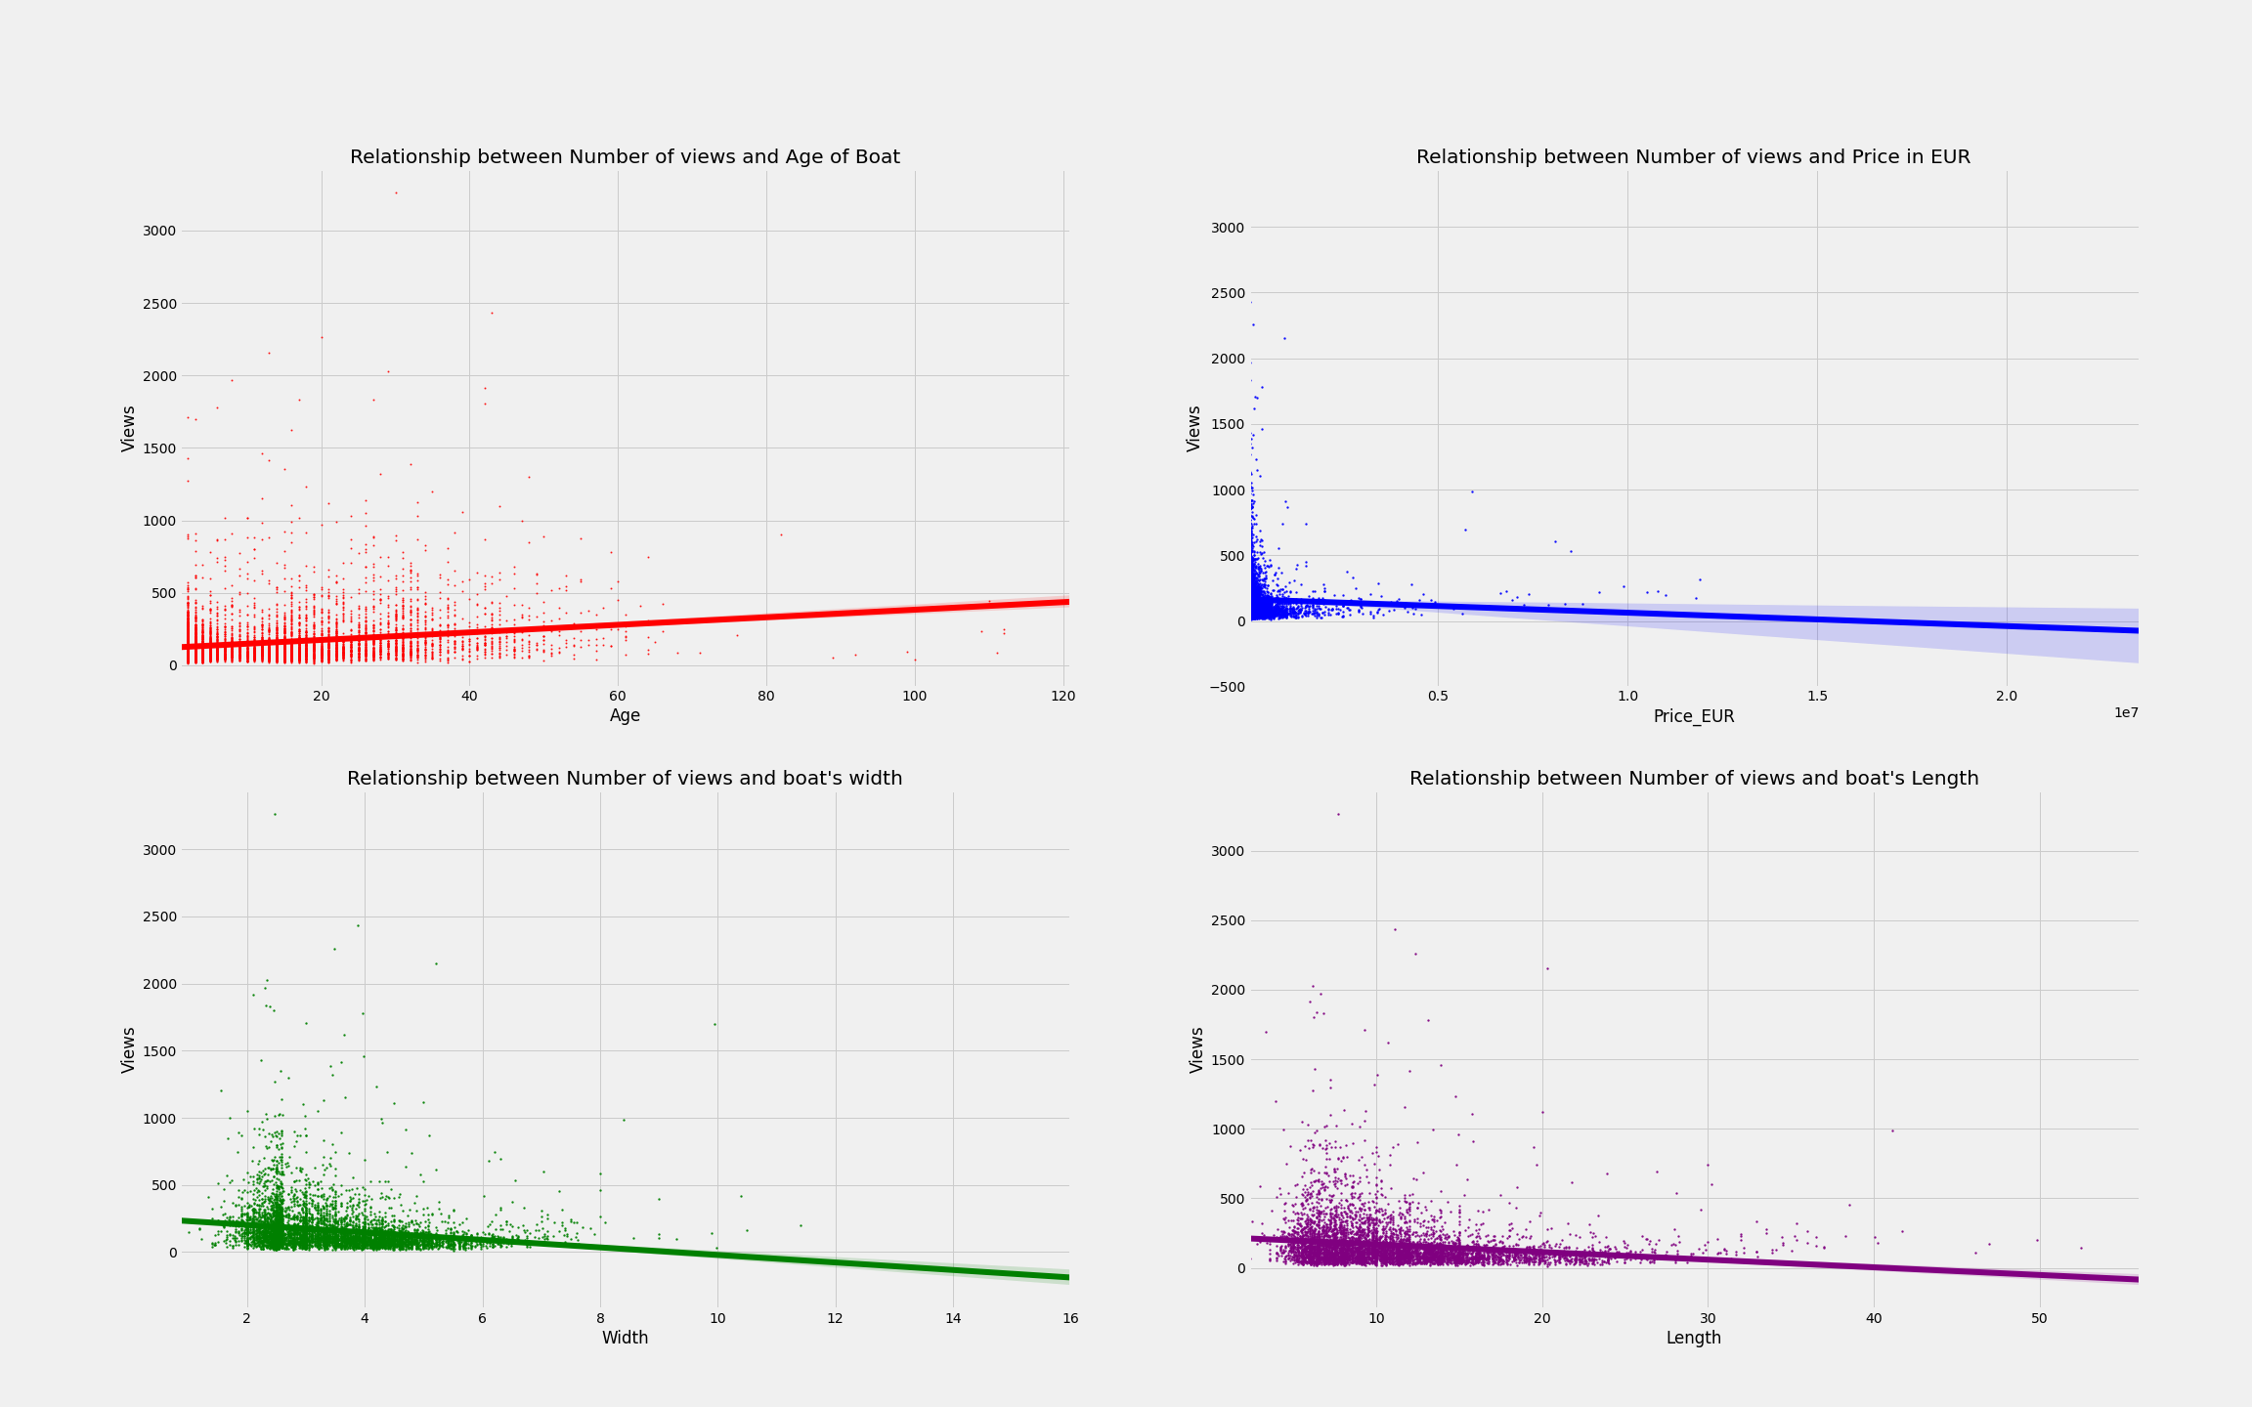
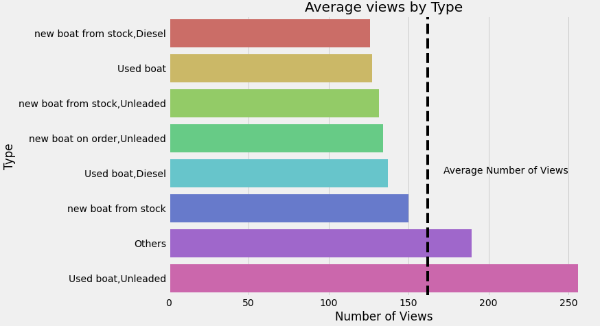
Exploratory Data Analysis Findings:

Slide 8
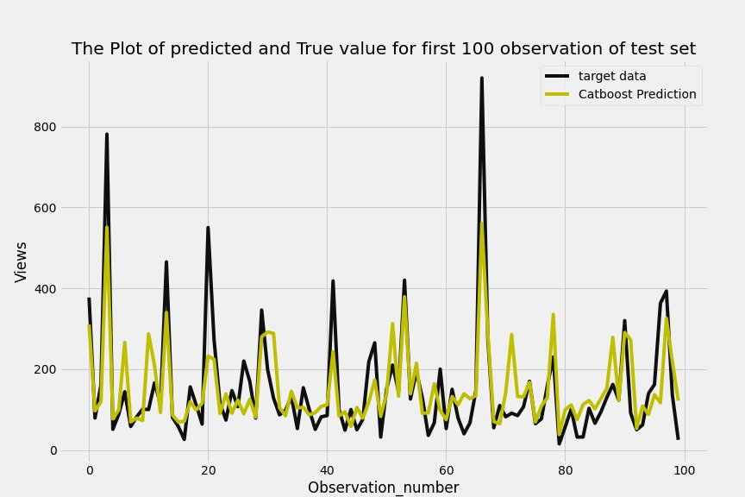
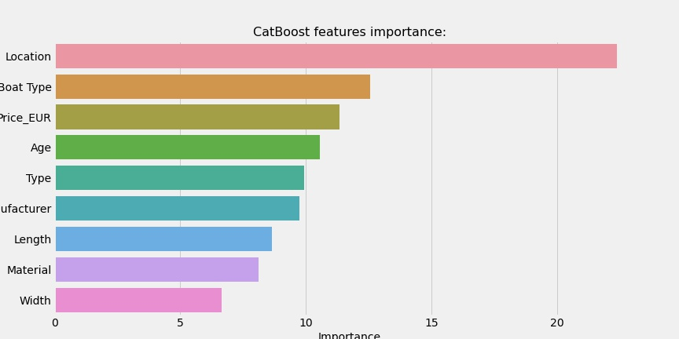
Predictive Model Findings

Slide 9
Summary and Future Work
Work Impact
Explore the areas where we see high number of views for a boat in each of its characteristics.
Next Step
Optimize this predictive model.
Built a predictive model that can help prevent listing boats that won’t get high number of views.
Deploy and host this model.
In case of survey trimming, I suggest to exclude “Material” characteristic.
In case of survey trimming, I can assess in the future if this would lead to an increase in the number of people who sign up.

Slide 10
Thank You For Your Attention !

